Slide 1

W4111 – 02: Introduction to Databases
Lecture 3,4: ER Modeling, SQL, Relational
Donald F. Ferguson dff9@Columbia.edu
TRANSCENDING DISCIPLINES, TRANSFORMING LIVES

Slide 2
Today’s Lecture – What You Need for HW 1
Programming and No-Programming HW/Projects Direction
Entity-Relationship Modeling:
Subset of Chapter 6 from recommended textbook.
Slides should be enough and there is a lot of online material.
Crow’s Foot Notation:
Simpler and more compact.
Very similar to what MySQL uses.
Demo of MySQL tools.
Introduction to Some Patterns in SQL DDL
Some Details on SQL DML SELECT.
Interwoven with Some Demos.
2 | W4111_02_S20: Introduction to Databases -- Lecture 3,4

Slide 3
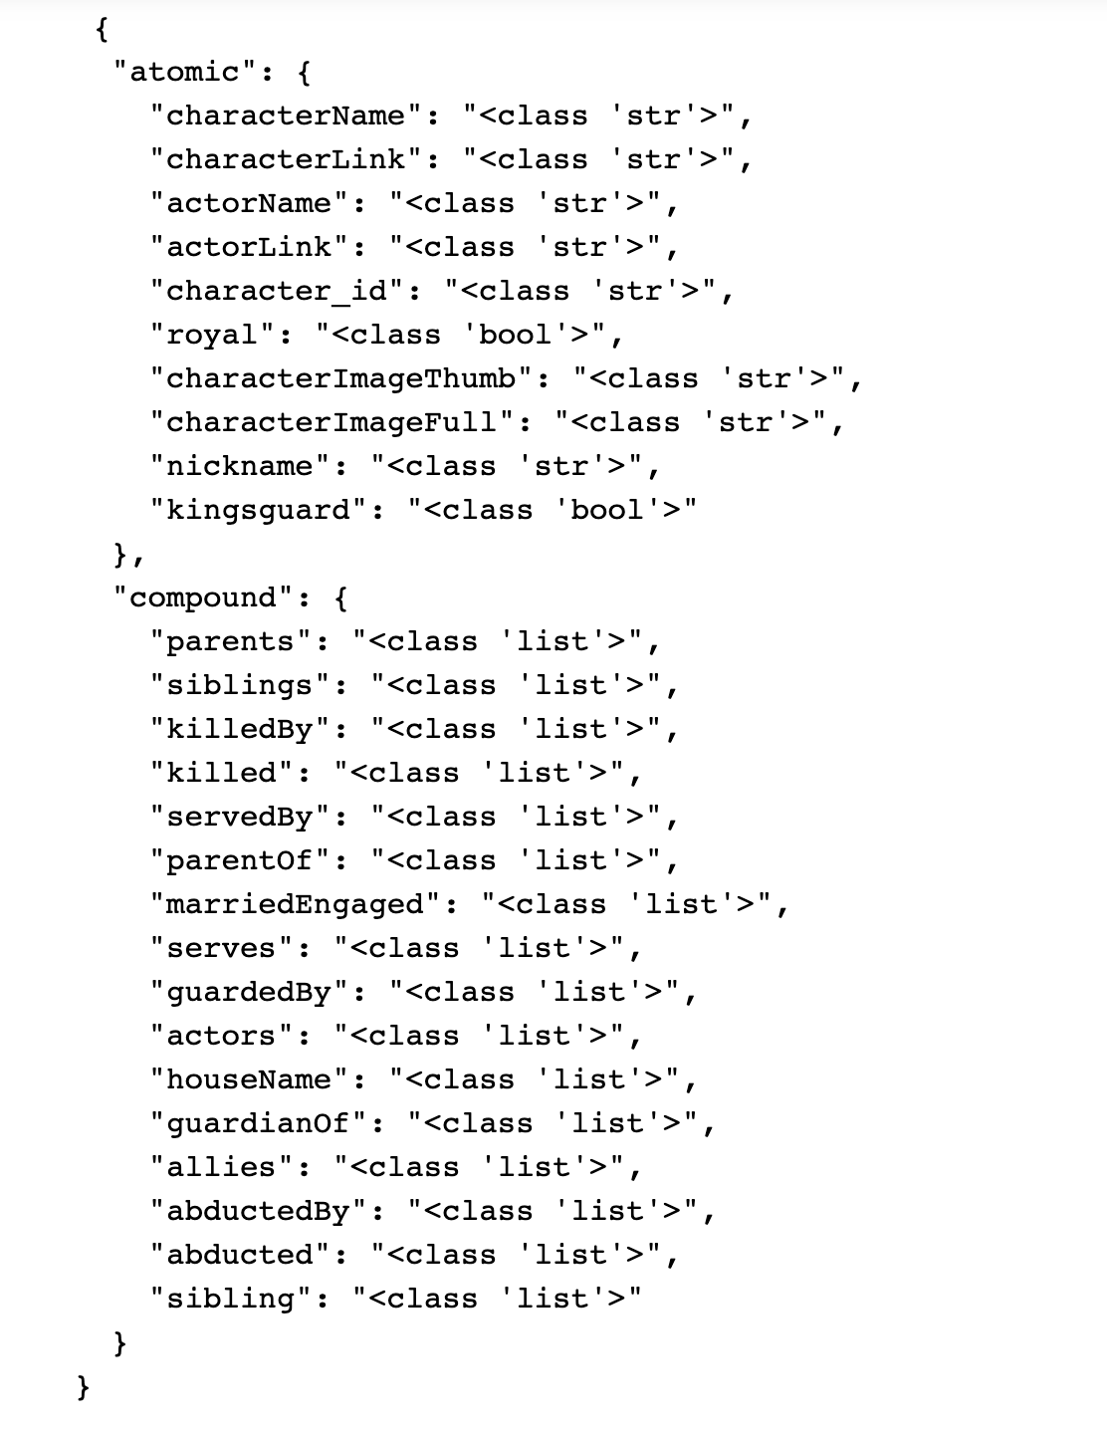
GoT Characters.json
There are some strange things …
There are siblings and sibling. A little analysis indicates that this must be a typo.
There are
actors and actorName.
There is also actorLink.
The remainder seem to be relationships/associations between characters.
Some are unidirectional but paired, e.g. killed, killedBy.
Bi-directional, allies, siblings.
At least one relationship, actors, has properties.
characterName is “mostly” unique but there are some entities that have the same character name.
3 | W4111_02_S20: Introduction to Databases -- Lecture 3,4

Slide 4
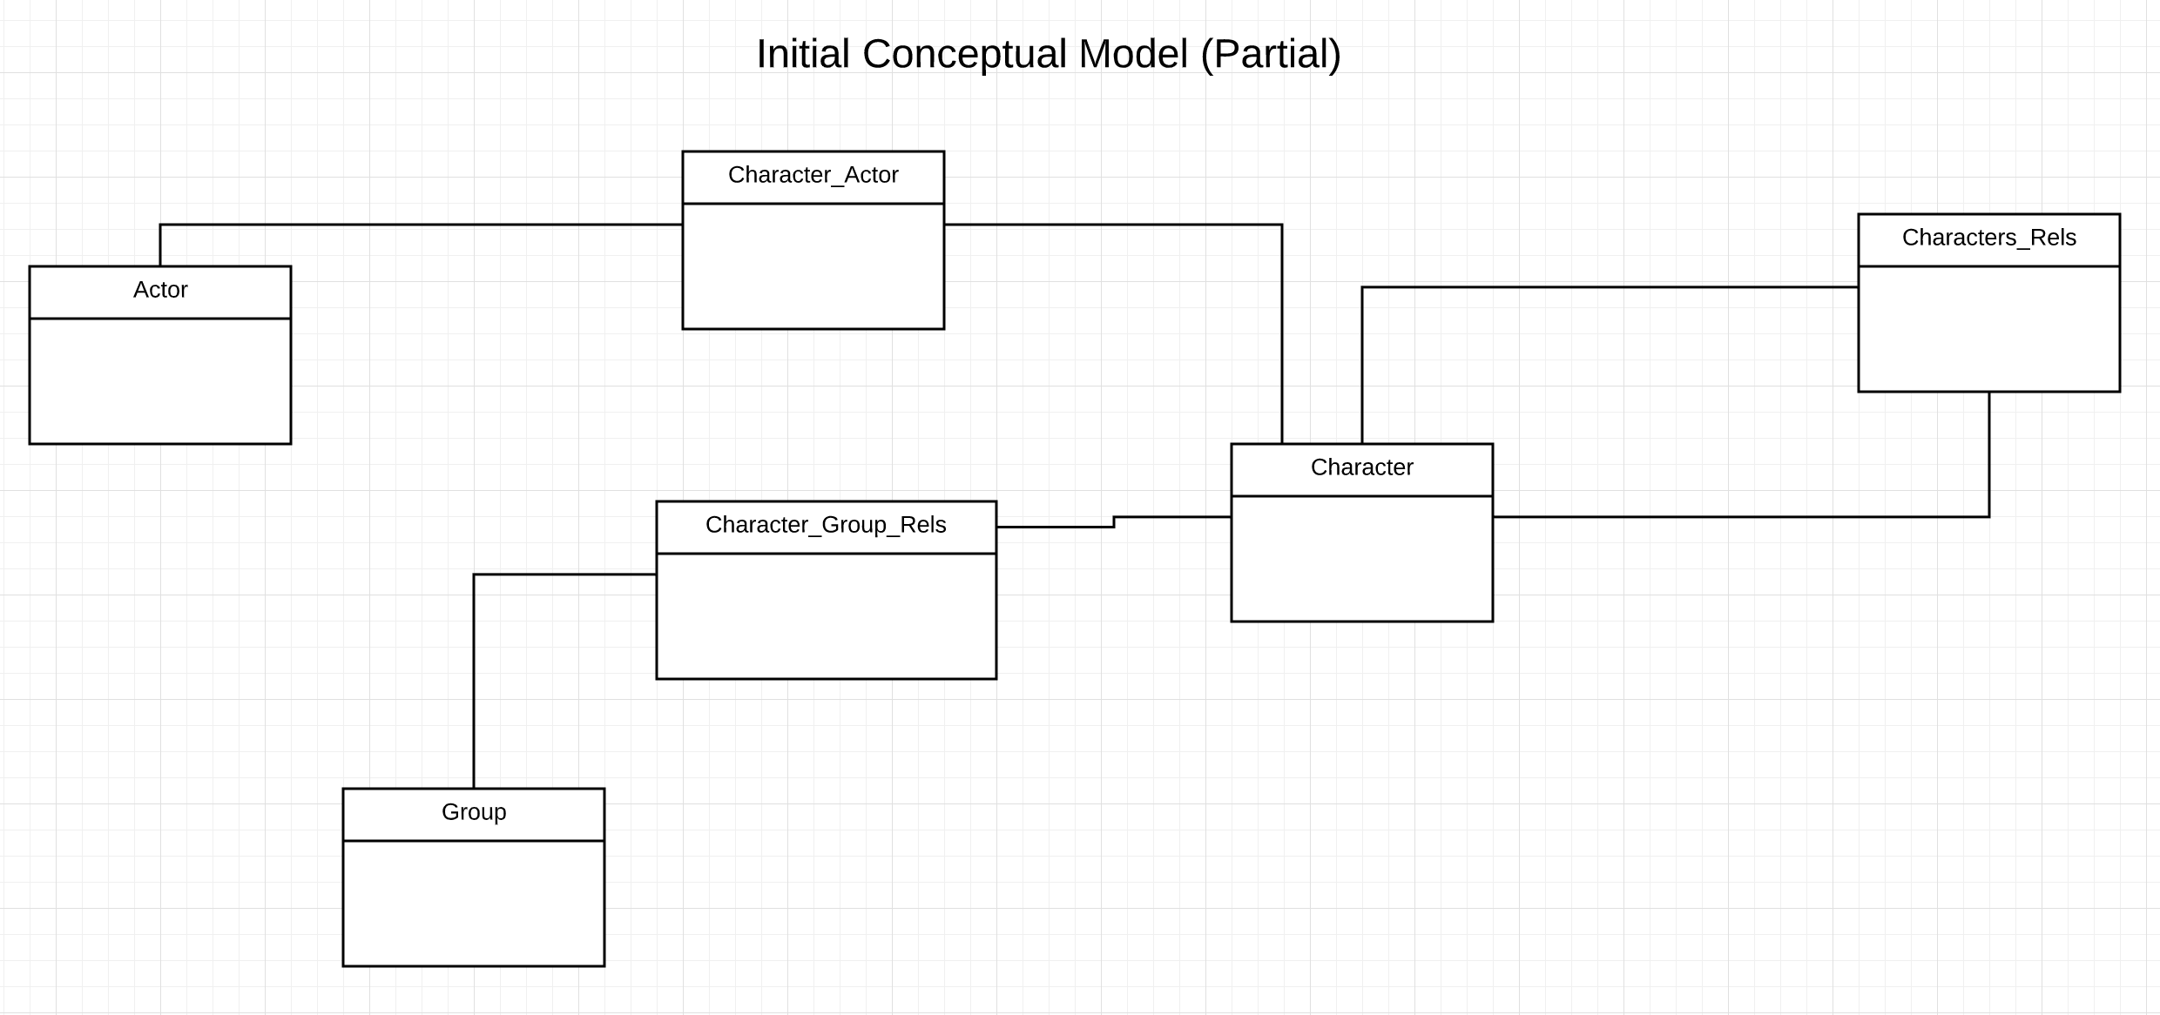
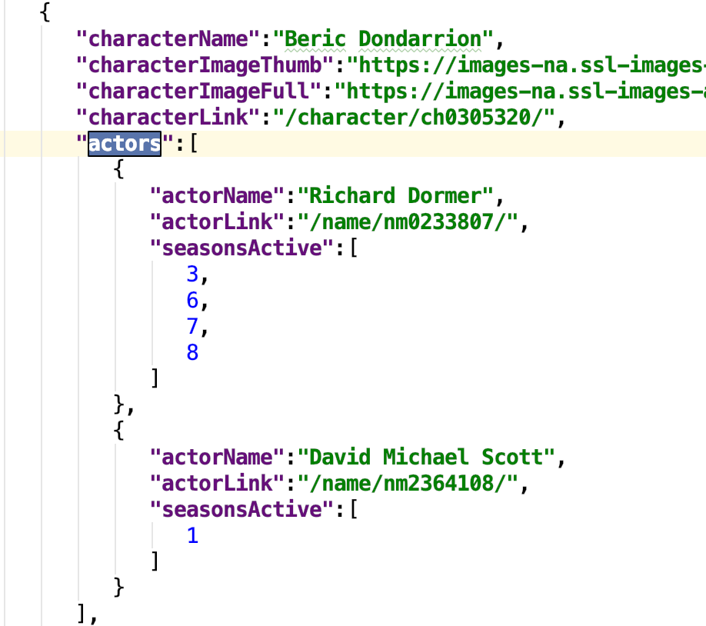
GoT Characters.json – Conceptual Model Decisions
Collapse things like:
Killed, killedBy into
Kill with source, target
IsBidirectional
This is actually more at the logical level.
Replace things like:
Siblings, House, Allies into the same concept
Membership in a group.
The use of entities sets to implement relationships helps with:
Many-to-Many
Properties on relationships
4 | W4111_02_S20: Introduction to Databases -- Lecture 3,4

Slide 5
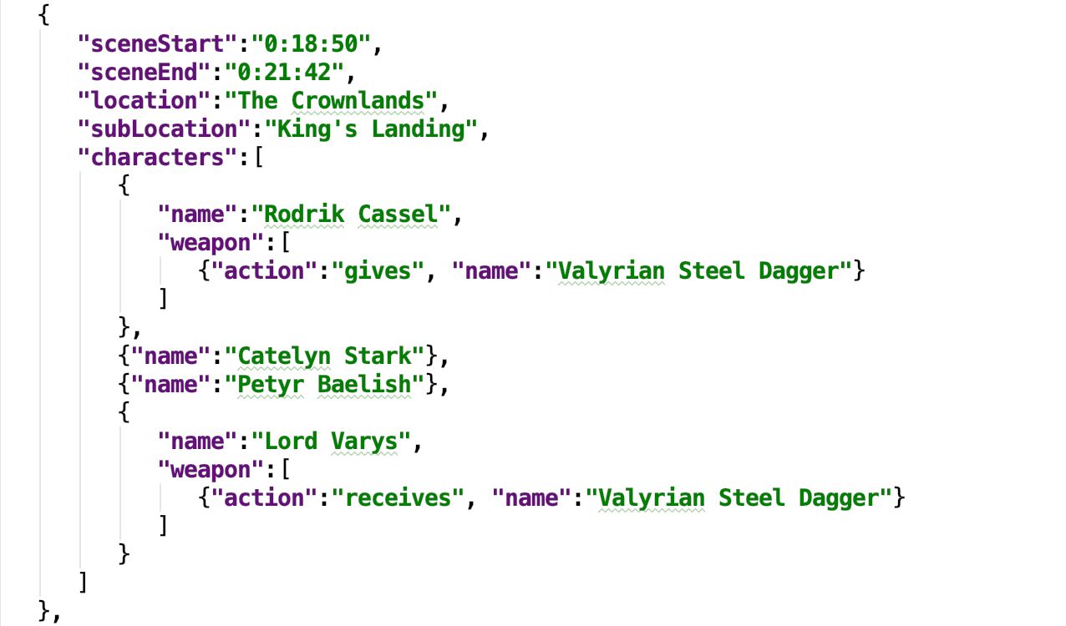
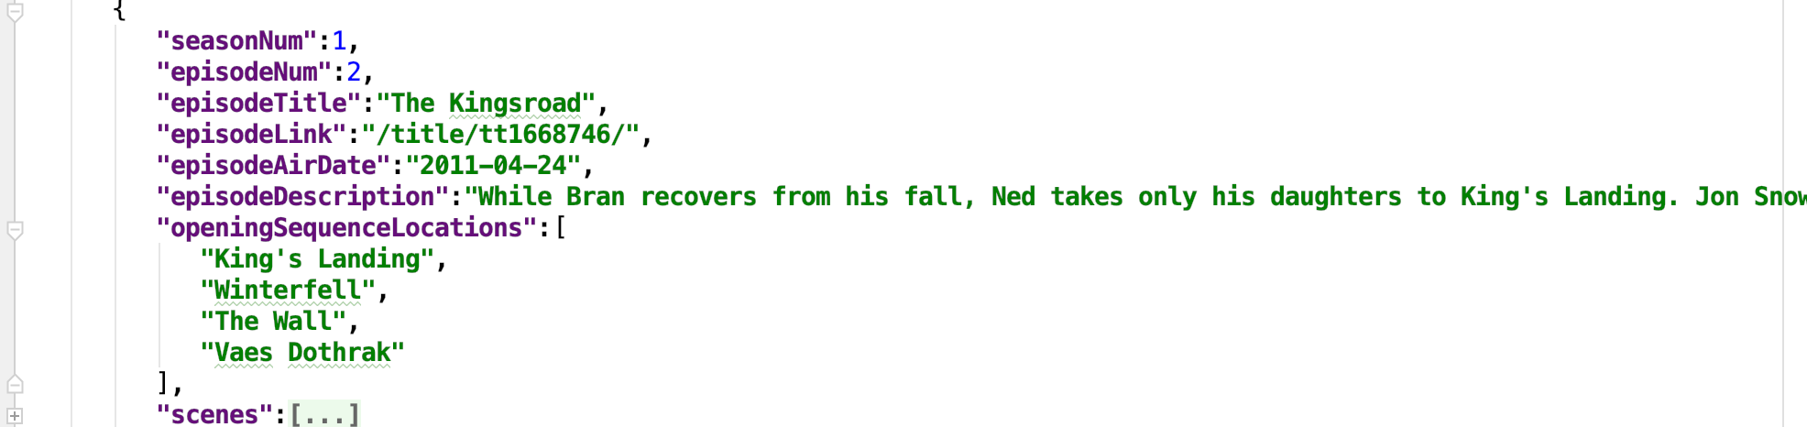
episodes.json – Data File Analysis
Example Scene
Example Episode
The average number of scenes per episode is: 57
5 | W4111_02_S20: Introduction to Databases -- Lecture 3,4

Slide 6
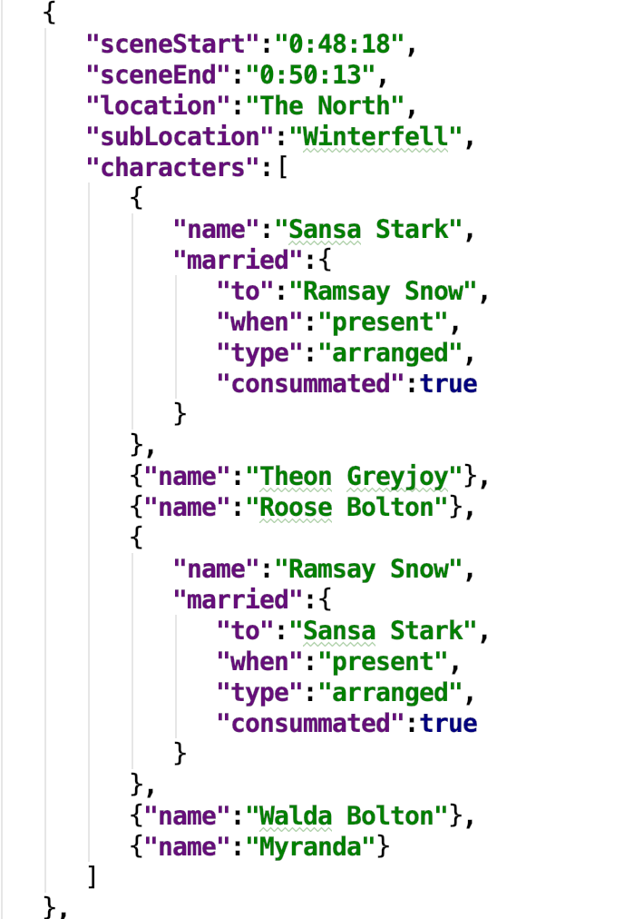
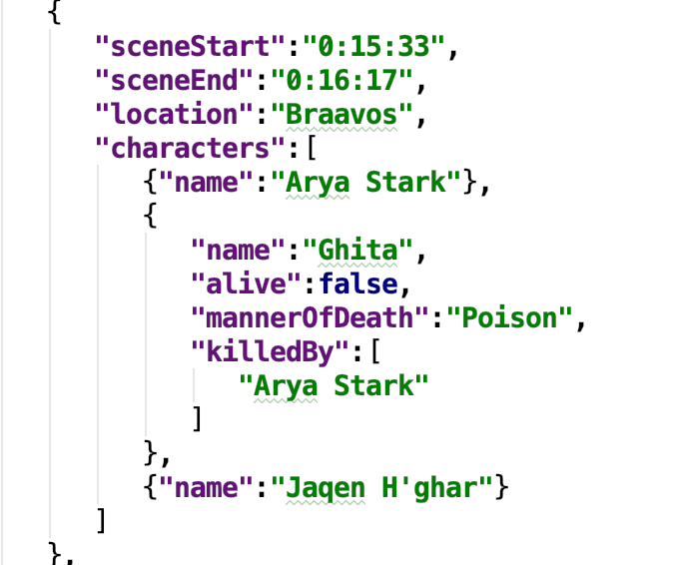
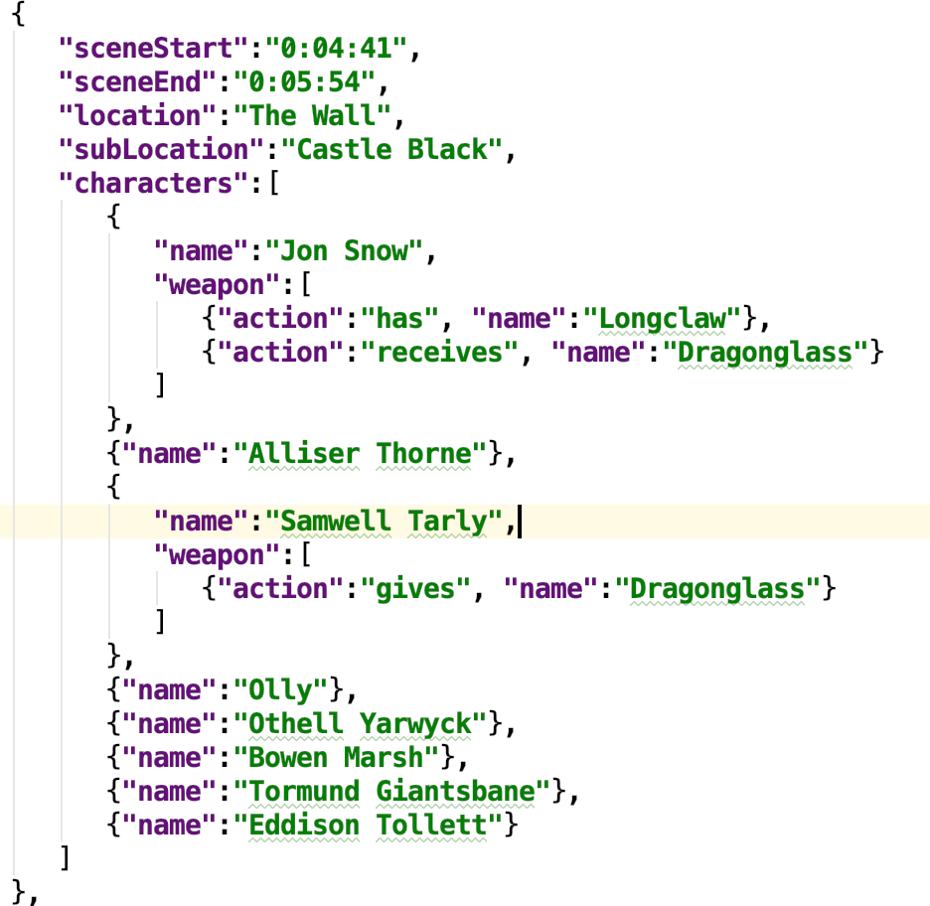
episodes.json – Scene Analysis
Scene Examples
6 | W4111_02_S20: Introduction to Databases -- Lecture 3,4

Slide 7
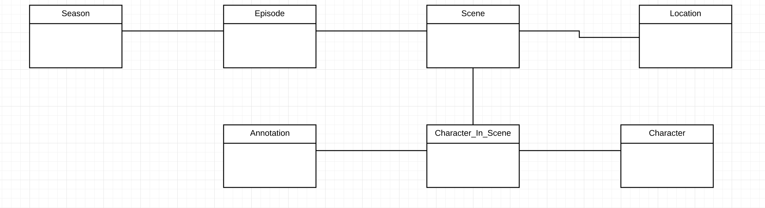
episodes.json: Episode, Scene Conceptual Model
This all seems pretty straightforward.
There are at least three nuances/complexities:
There are annotations/modifications to characters in a scene that seem hard to map into a relational structure. Appear to be inherently semi-structured.
There is a ternary relationship (scene, character, annotation).
Season is logically an entity, and may have properties in the future, but does not have any now.
7 | W4111_02_S20: Introduction to Databases -- Lecture 3,4

Slide 8
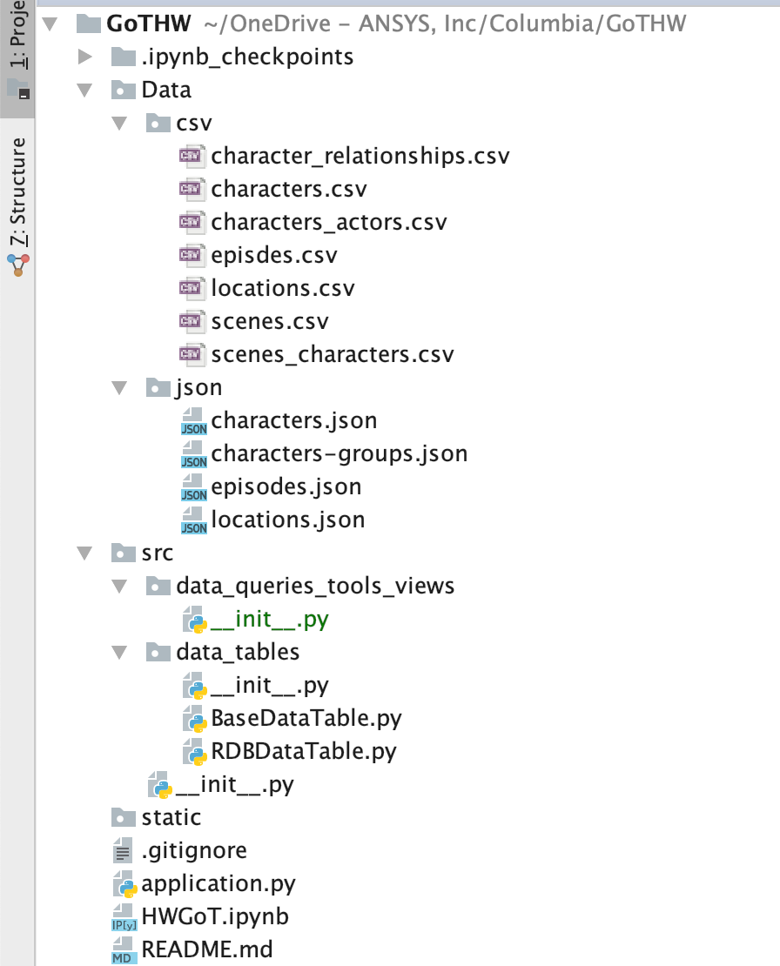
GoTGW Initial Project Structure
Data:
Downloaded files, currently from “32 Game of Thrones Data Visualizations”
Processed (by DFF) and converted into CSVs.
Will expand and grow over time.
(No Programming) Tools and queries for
Loading and transforming data.
Defining views.
Data table abstraction and RDB impl. Will add more implementations. (Programming Track)
UI content, e.g. HTML, CSS (DFF or others)
REST API handler (mostly by DFF, some programming track)
Analytics notebook.
8 | W4111_02_S20: Introduction to Databases -- Lecture 3,4

Slide 9
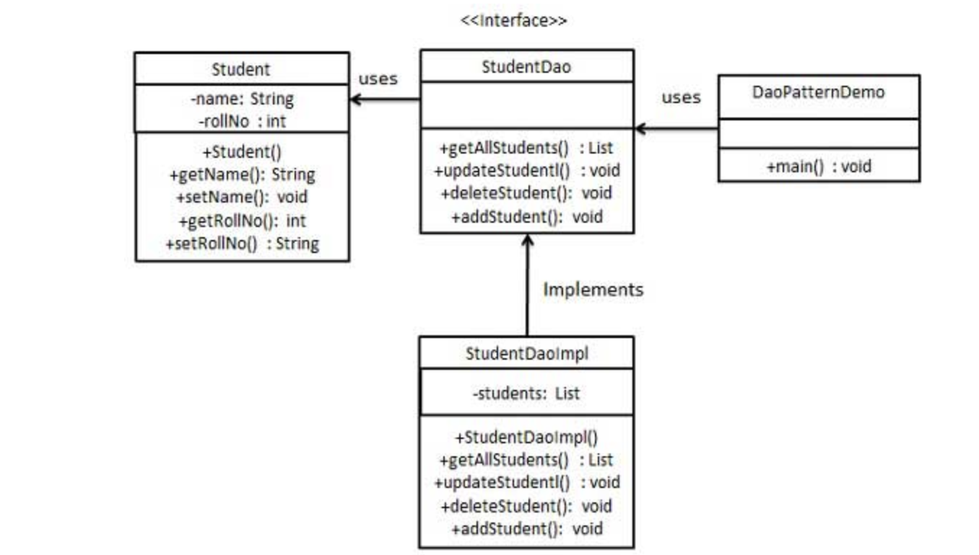
Data Access Object Pattern
Recurring pattern for simplifying application access to data and APIs.
9 | W4111_02_S20: Introduction to Databases -- Lecture 3,4

Slide 10

Continuing ER Model, Relational, SQL
10 | W4111_02_S20: Introduction to Databases -- Lecture 3,4

Slide 11
Chapter 3: Introduction to SQL

Slide 12
Integrity Constraints in Create Table
Types of integrity constraints
primary key (A₁, ..., A_{n} )
foreign key (A_{m}, ..., A_{n} ) references r
not null
SQL prevents any update to the database that violates an integrity constraint.
Example:
create table instructor ( ID char(5), name varchar(20) not null, dept_name varchar(20), salary numeric(8,2), primary key (ID), foreign key (dept_name) references department);
(DFF) There are also:
Check constraints.
Default values.
Generated column values.
… …

Slide 13
And a Few More Relation Definitions
create table student ( ID varchar(5), name varchar(20) not null, dept_name varchar(20), tot_cred numeric(3,0), primary key (ID),
foreign key (dept_name) references department);
create table takes ( ID varchar(5), course_id varchar(8), sec_id varchar(8), semester varchar(6), year numeric(4,0), grade varchar(2),
primary key (ID, course_id, sec_id, semester, year) ,
foreign key (ID) references student, foreign key (course_id, sec_id, semester, year) references section);

Slide 14
And more still
create table course ( course_id varchar(8), title varchar(50), dept_name varchar(20), credits numeric(2,0),
primary key (course_id),
foreign key (dept_name) references department);

Slide 15
Set Operations
Find courses that ran in Fall 2017 or in Spring 2018
(select course_id from section where sem = 'Fall' and year = 2017) union (select course_id from section where sem = 'Spring' and year = 2018)
Find courses that ran in Fall 2017 and in Spring 2018
(select course_id from section where sem = 'Fall' and year = 2017) intersect (select course_id from section where sem = 'Spring' and year = 2018)
Find courses that ran in Fall 2017 but not in Spring 2018
(select course_id from section where sem = 'Fall' and year = 2017) except (select course_id from section where sem = 'Spring' and year = 2018)

Slide 16
Set Operations (Cont.)
Set operations union, intersect, and except
Each of the above operations automatically eliminates duplicates
To retain all duplicates use the
union all,
intersect all
except all.
(DFF) Not all databases support all the set operations. There are workarounds using JOIN and UNION.

Slide 17
Set Membership

Slide 18
Set Membership
Find courses offered in Fall 2017 and in Spring 2018
Find courses offered in Fall 2017 but not in Spring 2018
select distinct course_id
from section
where semester = 'Fall' and year= 2017 and course_id in (select course_id
from section
where semester = 'Spring' and year= 2018);
select distinct course_id
from section
where semester = 'Fall' and year= 2017 and course_id not in (select course_id
from section
where semester = 'Spring' and year= 2018);

Slide 19
Set Membership (Cont.)
Name all instructors whose name is neither “Mozart” nor Einstein”
select distinct name
from instructor
where name not in ('Mozart', 'Einstein')
Find the total number of (distinct) students who have taken course sections taught by the instructor with ID 10101
Note: Above query can be written in a much simpler manner. The formulation above is simply to illustrate SQL features
select count (distinct ID)
from takes
where (course_id, sec_id, semester, year) in (select course_id, sec_id, semester, year
from teaches
where teaches.ID= 10101);

Slide 20
Set Comparison

Slide 21
Set Comparison – “some” Clause
Find names of instructors with salary greater than that of some (at least one) instructor in the Biology department.
Same query using > some clause
select distinct T.name
from instructor as T, instructor as S
where T.salary > S.salary and S.dept name = 'Biology';
select name
from instructor
where salary > some (select salary
from instructor
where dept name = 'Biology');

Slide 22
Definition of “some” Clause
F <comp> some r ⇔ ∃ t ∈ r such that (F <comp> t ) Where <comp> can be: <, ≤, >, =, ≠
0
(5 < some
5
) = true
(read: 5 < some tuple in the relation)
6
0
(5 < some
5
) = false
0
(5 = some
) = true
5
0
(5 ≠ some
5
) = true (since 0 ≠ 5)
(= some) ≡ in
However, (≠ some) ≡ not in

Slide 23
Set Comparison – “all” Clause
Find the names of all instructors whose salary is greater than the salary of all instructors in the Biology department.
select name
from instructor
where salary > all (select salary
from instructor
where dept name = 'Biology');

Slide 24
Definition of “all” Clause
F <comp> all r ⇔ ∀ t ∈ r (F <comp> t)
0
(5 < all
5
) = false
6
6
(5 < all
) = true
10
4
(5 = all
) = false
5
4
(5 ≠ all
) = true (since 5 ≠ 4 and 5 ≠ 6)
6
(≠ all) ≡ not in
However, (= all) ≡ in

Slide 25
Test for Empty Relations
The exists construct returns the value true if the argument subquery is nonempty.
exists r ⇔ r ≠ Ø
not exists r ⇔ r = Ø

Slide 26
Use of “exists” Clause
Yet another way of specifying the query “Find all courses taught in both the Fall 2017 semester and in the Spring 2018 semester”
select course_id from section as S where semester = 'Fall' and year = 2017 and exists (select * from section as T where semester = 'Spring' and year= 2018 and S.course_id = T.course_id);
Correlation name – variable S in the outer query
Correlated subquery – the inner query

Slide 27
Use of “not exists” Clause
Find all students who have taken all courses offered in the Biology department.
Note that X – Y = Ø ⇔ X ⊆ Y
Note: Cannot write this query using = all and its variants
select distinct S.ID, S.name
from student as S
where not exists ( (select course_id
from course
where dept_name = 'Biology')
except
(select T.course_id
from takes as T
where S.ID = T.ID));
First nested query lists all courses offered in Biology
Second nested query lists all courses a particular student took

Slide 28
Test for Absence of Duplicate Tuples
The unique construct tests whether a subquery has any duplicate tuples in its result.
The unique construct evaluates to “true” if a given subquery contains no duplicates .
Find all courses that were offered at most once in 2017
select T.course_id from course as T where unique ( select R.course_id from section as R where T.course_id= R.course_id and R.year = 2017);

Slide 29
Subqueries in the From Clause

Slide 30
Subqueries in the Form Clause
SQL allows a subquery expression to be used in the from clause
Find the average instructors’ salaries of those departments where the average salary is greater than $42,000.”
select dept_name, avg_salary from ( select dept_name, avg (salary) as avg_salary from instructor group by dept_name) where avg_salary > 42000;
Note that we do not need to use the having clause
Another way to write above query
select dept_name, avg_salary from ( select dept_name, avg (salary) from instructor group by dept_name)
as dept_avg (dept_name, avg_salary)
where avg_salary > 42000;

Slide 31
With Clause
The with clause provides a way of defining a temporary relation whose definition is available only to the query in which the with clause occurs.
Find all departments with the maximum budget with max_budget (value) as (select max(budget) from department) select department.name from department, max_budget where department.budget = max_budget.value;

Slide 32
Complex Queries using With Clause
Find all departments where the total salary is greater than the average of the total salary at all departments
with dept _total (dept_name, value) as
(select dept_name, sum(salary)
from instructor
group by dept_name),
dept_total_avg(value) as
(select avg(value)
from dept_total)
select dept_name
from dept_total, dept_total_avg
where dept_total.value > dept_total_avg.value;

Slide 33
Scalar Subquery
Scalar subquery is one which is used where a single value is expected
List all departments along with the number of instructors in each department
select dept_name, ( select count(*) from instructor where department.dept_name = instructor.dept_name) as num_instructors from department;
Runtime error if subquery returns more than one result tuple

Slide 34
Modification of the Database
Deletion of tuples from a given relation.
Insertion of new tuples into a given relation
Updating of values in some tuples in a given relation

Slide 35
Deletion
Delete all instructors
delete from instructor
Delete all instructors from the Finance department delete from instructor where dept_name= 'Finance’;
Delete all tuples in the instructor relation for those instructors associated with a department located in the Watson building.
delete from instructor where dept name in (select dept name from department where building = 'Watson');

Slide 36
Deletion (Cont.)
Delete all instructors whose salary is less than the average salary of instructors
Problem: as we delete tuples from instructor, the average salary changes
Solution used in SQL:
First, compute avg (salary) and find all tuples to delete
Next, delete all tuples found above (without recomputing avg or retesting the tuples)
delete from instructor
where salary < (select avg (salary)
from instructor);

Slide 37
Insertion
Add a new tuple to course
insert into course values ('CS-437', 'Database Systems', 'Comp. Sci.', 4);
or equivalently
insert into course (course_id, title, dept_name, credits) values ('CS-437', 'Database Systems', 'Comp. Sci.', 4);
Add a new tuple to student with tot_creds set to null
insert into student values ('3003', 'Green', 'Finance', null);

Slide 38
Insertion (Cont.)
Make each student in the Music department who has earned more than 144 credit hours an instructor in the Music department with a salary of $18,000.
insert into instructor select ID, name, dept_name, 18000 from student where dept_name = 'Music' and total_cred > 144;
The select from where statement is evaluated fully before any of its results are inserted into the relation.
Otherwise queries like
insert into table1 select * from table1
would cause problem

Slide 39
Updates
Give a 5% salary raise to all instructors
update instructor set salary = salary * 1.05
Give a 5% salary raise to those instructors who earn less than 70000 update instructor set salary = salary * 1.05 where salary < 70000;
Give a 5% salary raise to instructors whose salary is less than average
update instructor set salary = salary * 1.05 where salary < (select avg (salary) from instructor);

Slide 40
Updates (Cont.)
Increase salaries of instructors whose salary is over $100,000 by 3%, and all others by a 5%
Write two update statements:
update instructor set salary = salary * 1.03 where salary > 100000; update instructor set salary = salary * 1.05 where salary <= 100000;
The order is important
Can be done better using the case statement (next slide)

Slide 41
Case Statement for Conditional Updates
Same query as before but with case statement
update instructor set salary = case when salary <= 100000 then salary * 1.05 else salary * 1.03 end

Slide 42
Updates with Scalar Subqueries
Recompute and update tot_creds value for all students
update student S set tot_cred = (select sum(credits) from takes, course where takes.course_id = course.course_id and S.ID= takes.ID.and takes.grade <> 'F' and takes.grade is not null);
Sets tot_creds to null for students who have not taken any course
Instead of sum(credits), use:
case when sum(credits) is not null then sum(credits) else 0 end

Slide 43
Chapter 4 : Intermediate SQL

Slide 44
Joined Relations
Join operations take two relations and return as a result another relation.
A join operation is a Cartesian product which requires that tuples in the two relations match (under some condition). It also specifies the attributes that are present in the result of the join
The join operations are typically used as subquery expressions in the from clause
Three types of joins:
Natural join
Inner join
Outer join

Slide 45
Natural Join in SQL
Natural join matches tuples with the same values for all common attributes, and retains only one copy of each common column.
List the names of instructors along with the course ID of the courses that they taught
select name, course_id from students, takes where student.ID = takes.ID;
Same query in SQL with “natural join” construct
select name, course_id from student natural join takes;

Slide 46
Natural Join in SQL (Cont.)
The from clause can have multiple relations combined using natural join:
select A₁, A₂, … A_{n} from r₁ natural join r₂ natural join .. natural join r_{n} where P ;

Slide 47
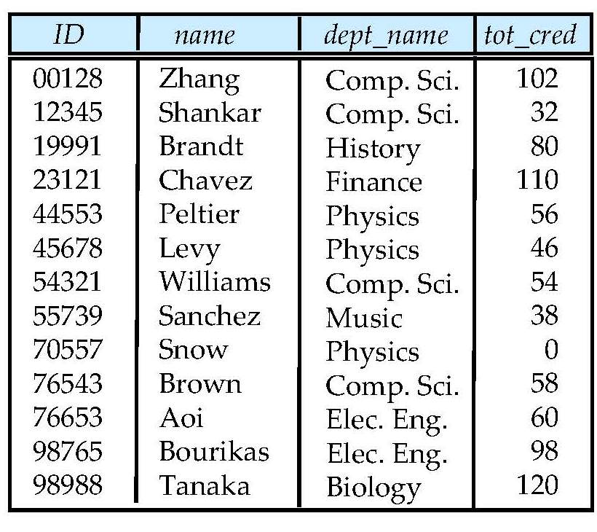
Student Relation

Slide 48
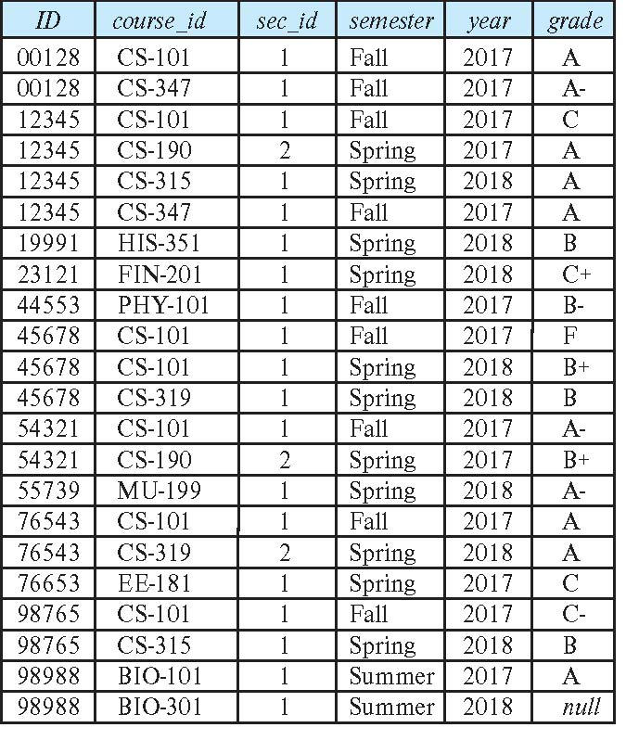
Takes Relation

Slide 49
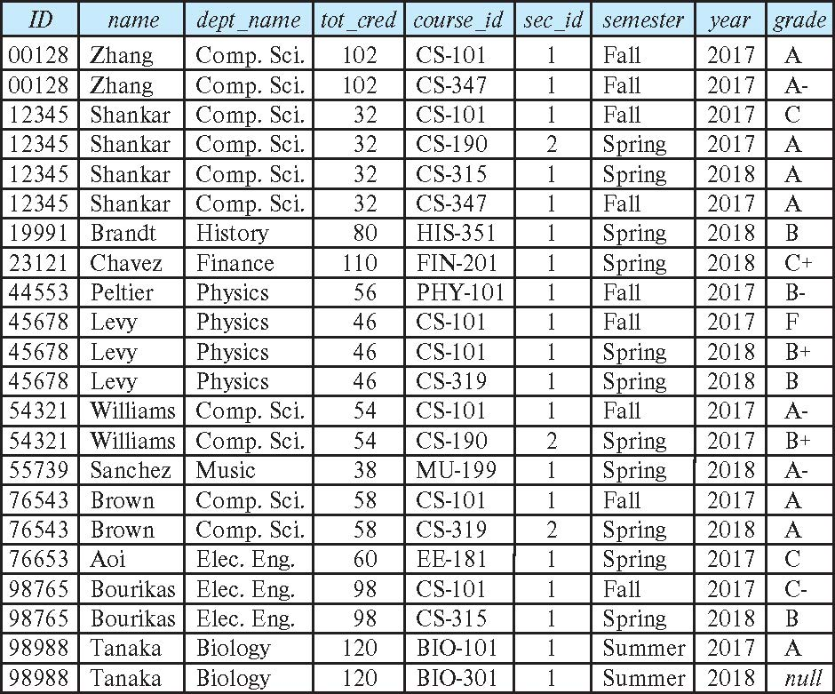
student natural join takes

Slide 50
Dangerous in Natural Join
Beware of unrelated attributes with same name which get equated incorrectly
Example -- List the names of students instructors along with the titles of courses that they have taken
Correct version
select name, title from student natural join takes, course where takes.course_id = course.course_id;
Incorrect version
select name, title from student natural join takes natural join course;
This query omits all (student name, course title) pairs where the student takes a course in a department other than the student's own department.
The correct version (above), correctly outputs such pairs.

Slide 51
Natural Join with Using Clause
To avoid the danger of equating attributes erroneously, we can use the “using” construct that allows us to specify exactly which columns should be equated.
Query example
select name, title from (student natural join takes) join course using (course_id)

Slide 52
Join Condition
The on condition allows a general predicate over the relations being joined
This predicate is written like a where clause predicate except for the use of the keyword on
Query example
select * from student join takes on student_ID = takes_ID
The on condition above specifies that a tuple from student matches a tuple from takes if their ID values are equal.
Equivalent to:
select * from student , takes where student_ID = takes_ID

Slide 53
Join Condition (Cont.)
The on condition allows a general predicate over the relations being joined.
This predicate is written like a where clause predicate except for the use of the keyword on.
Query example
select * from student join takes on student_ID = takes_ID
The on condition above specifies that a tuple from student matches a tuple from takes if their ID values are equal.
Equivalent to:
select * from student , takes where student_ID = takes_ID

Slide 54
Outer Join
An extension of the join operation that avoids loss of information.
Computes the join and then adds tuples form one relation that does not match tuples in the other relation to the result of the join.
Uses null values.
Three forms of outer join:
left outer join
right outer join
full outer join

Slide 55
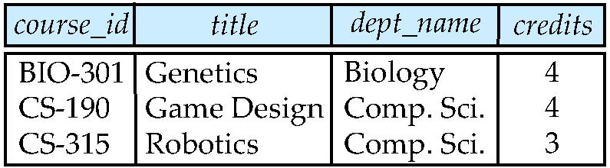
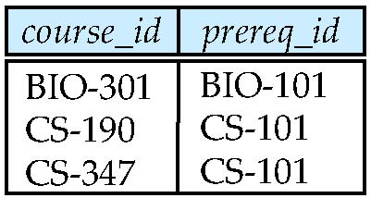
Outer Join Examples
Relation course
Relation prereq
Observe that
course information is missing CS-437
prereq information is missing CS-315
x

Slide 56
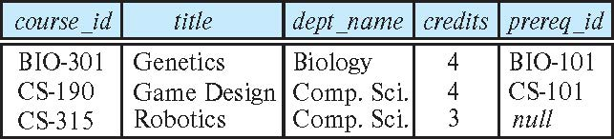
Left Outer Join
course natural left outer join prereq
In relational algebra: course ⟕ prereq

Slide 57
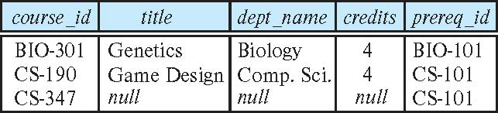
Right Outer Join
course natural right outer join prereq
In relational algebra: course ⟖ prereq

Slide 58
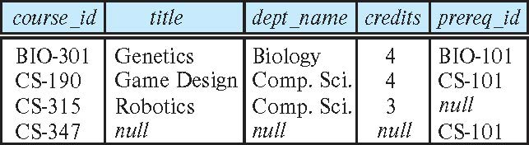
Full Outer Join
course natural full outer join prereq
In relational algebra: course ⟗ prereq

Slide 59
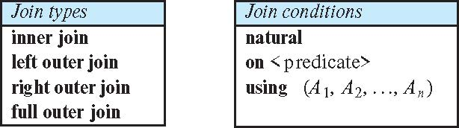
Joined Types and Conditions
Join operations take two relations and return as a result another relation.
These additional operations are typically used as subquery expressions in the from clause
Join condition – defines which tuples in the two relations match.
Join type – defines how tuples in each relation that do not match any tuple in the other relation (based on the join condition) are treated.

Slide 60
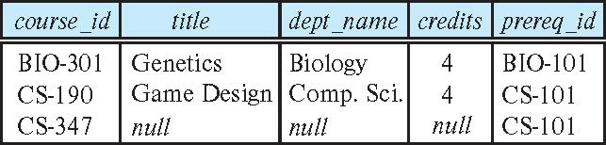
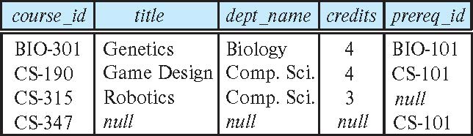
Joined Relations – Examples
course natural right outer join prereq
course full outer join prereq using (course_id)

Slide 61
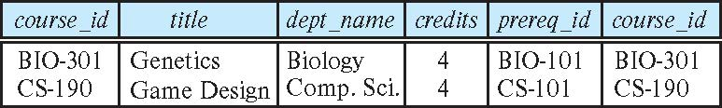
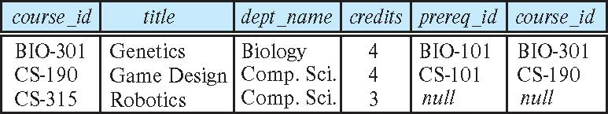
Joined Relations – Examples
course inner join prereq on course.course_id = prereq.course_id
What is the difference between the above, and a natural join?
course left outer join prereq on course.course_id = prereq.course_id

Slide 62
Joined Relations – Examples
course natural right outer join prereq
course full outer join prereq using (course_id)

Slide 63
How to Think About Joins
Remember
The rows in the result are of the form: {ai, aj, am, b1,b7,b11}
Represent a pair of rows that “matched” on JOIN condition.
The way to think about these set diagrams is:
The cartesian product is all possible pairs of rows.
The JOINs represent the subsets of the cartesian product.
63 | W4111_02_S20: Introduction to Databases -- Lecture 3,4

Slide 64
Views
In some cases, it is not desirable for all users to see the entire logical model (that is, all the actual relations stored in the database.)
Consider a person who needs to know an instructors name and department, but not the salary. This person should see a relation described, in SQL, by select ID, name, dept_name from instructor
A view provides a mechanism to hide certain data from the view of certain users.
Any relation that is not of the conceptual model but is made visible to a user as a “virtual relation” is called a view.

Slide 65
View Definition
A view is defined using the create view statement which has the form
create view v as < query expression >
where <query expression> is any legal SQL expression. The view name is represented by v.
Once a view is defined, the view name can be used to refer to the virtual relation that the view generates.
View definition is not the same as creating a new relation by evaluating the query expression
Rather, a view definition causes the saving of an expression; the expression is substituted into queries using the view.

Slide 66
View Definition and Use
A view of instructors without their salary
create view faculty as select ID, name, dept_name from instructor
Find all instructors in the Biology department
select name from faculty where dept_name = 'Biology'
Create a view of department salary totals
create view departments_total_salary(dept_name, total_salary) as select dept_name, sum (salary) from instructor group by dept_name;

Slide 67
Views Defined Using Other Views
One view may be used in the expression defining another view
A view relation v₁ is said to depend directly on a view relation v₂ if v₂ is used in the expression defining v₁
A view relation v₁ is said to depend on view relation v₂ if either v₁ depends directly to v₂ or there is a path of dependencies from v₁ to v₂
A view relation v is said to be recursive if it depends on itself.

Slide 68
Views Defined Using Other Views
create view physics_fall_2017 as select course.course_id, sec_id, building, room_number from course, section where course.course_id = section.course_id and course.dept_name = 'Physics' and section.semester = 'Fall' and section.year = '2017’;
create view physics_fall_2017_watson as select course_id, room_number from physics_fall_2017 where building= 'Watson';

Slide 69
View Expansion
Expand the view :
create view physics_fall_2017_watson as select course_id, room_number from physics_fall_2017 where building= 'Watson'
To:
create view physics_fall_2017_watson as
select course_id, room_number
from (select course.course_id, building, room_number
from course, section
where course.course_id = section.course_id
and course.dept_name = 'Physics'
and section.semester = 'Fall'
and section.year = '2017')
where building= 'Watson';

Slide 70
View Expansion (Cont.)
A way to define the meaning of views defined in terms of other views.
Let view v₁ be defined by an expression e₁ that may itself contain uses of view relations.
View expansion of an expression repeats the following replacement step:
repeat Find any view relation v_{i} in e₁ Replace the view relation v_{i} by the expression defining v_{i} until no more view relations are present in e₁
As long as the view definitions are not recursive, this loop will terminate

Slide 71
Materialized Views
Certain database systems allow view relations to be physically stored.
Physical copy created when the view is defined.
Such views are called Materialized view:
If relations used in the query are updated, the materialized view result becomes out of date
Need to maintain the view, by updating the view whenever the underlying relations are updated.

Slide 72
Update of a View
Add a new tuple to faculty view which we defined earlier
insert into faculty
values ('30765', 'Green', 'Music');
This insertion must be represented by the insertion into the instructor relation
Must have a value for salary.
Two approaches
Reject the insert
Inset the tuple
('30765', 'Green', 'Music', null)
into the instructor relation

Slide 73
Some Updates Cannot be Translated Uniquely
create view instructor_info as select ID, name, building from instructor, department where instructor.dept_name= department.dept_name;
insert into instructor_info
values ('69987', 'White', 'Taylor');
Issues
Which department, if multiple departments in Taylor?
What if no department is in Taylor?

Slide 74
And Some Not at All
create view history_instructors as select * from instructor where dept_name= 'History';
What happens if we insert
('25566', 'Brown', 'Biology', 100000)
into history_instructors?

Slide 75
View Updates in SQL
Most SQL implementations allow updates only on simple views
The from clause has only one database relation.
The select clause contains only attribute names of the relation, and does not have any expressions, aggregates, or distinct specification.
Any attribute not listed in the select clause can be set to null
The query does not have a group by or having clause.

Slide 76
Integrity Constraints
Integrity constraints guard against accidental damage to the database, by ensuring that authorized changes to the database do not result in a loss of data consistency.
A checking account must have a balance greater than $10,000.00
A salary of a bank employee must be at least $4.00 an hour
A customer must have a (non-null) phone number

Slide 77
Constraints on a Single Relation
not null
primary key
unique
check (P), where P is a predicate

Slide 78
Not Null Constraints
not null
Declare name and budget to be not null
name varchar(20) not null budget numeric(12,2) not null

Slide 79
Unique Constraints
unique ( A₁, A₂, …, A_{m})
The unique specification states that the attributes A₁, A₂, …, A_{m} form a candidate key.
Candidate keys are permitted to be null (in contrast to primary keys).

Slide 80
The check clause
The check (P) clause specifies a predicate P that must be satisfied by every tuple in a relation.
Example: ensure that semester is one of fall, winter, spring or summer
create table section
(course_id varchar (8),
sec_id varchar (8),
semester varchar (6),
year numeric (4,0),
building varchar (15),
room_number varchar (7),
time slot id varchar (4),
primary key (course_id, sec_id, semester, year),
check (semester in ('Fall', 'Winter', 'Spring', 'Summer')))

Slide 81
Referential Integrity
Ensures that a value that appears in one relation for a given set of attributes also appears for a certain set of attributes in another relation.
Example: If “Biology” is a department name appearing in one of the tuples in the instructor relation, then there exists a tuple in the department relation for “Biology”.
Let A be a set of attributes. Let R and S be two relations that contain attributes A and where A is the primary key of S. A is said to be a foreign key of R if for any values of A appearing in R these values also appear in S.

Slide 82
Referential Integrity (Cont.)
Foreign keys can be specified as part of the SQL create table statement
foreign key (dept_name) references department
By default, a foreign key references the primary-key attributes of the referenced table.
SQL allows a list of attributes of the referenced relation to be specified explicitly.
foreign key (dept_name) references department (dept_name)

Slide 83
Cascading Actions in Referential Integrity
When a referential-integrity constraint is violated, the normal procedure is to reject the action that caused the violation.
An alternative, in case of delete or update is to cascade
create table course ( (… dept_name varchar(20), foreign key (dept_name) references department on delete cascade on update cascade, . . .)
Instead of cascade we can use :
set null,
set default

Slide 84
Integrity Constraint Violation During Transactions
Consider:
create table person ( ID char(10), name char(40), mother char(10), father char(10), primary key ID, foreign key father references person, foreign key mother references person)
How to insert a tuple without causing constraint violation?
Insert father and mother of a person before inserting person
OR, set father and mother to null initially, update after inserting all persons (not possible if father and mother attributes declared to be not null)
OR defer constraint checking

Slide 85
Complex Check Conditions
The predicate in the check clause can be an arbitrary predicate that can include a subquery.
check (time_slot_id in (select time_slot_id from time_slot))
The check condition states that the time_slot_id in each tuple in the section relation is actually the identifier of a time slot in the time_slot relation.
The condition has to be checked not only when a tuple is inserted or modified in section , but also when the relation time_slot changes

Slide 86
Assertions
An assertion is a predicate expressing a condition that we wish the database always to satisfy.
The following constraints, can be expressed using assertions:
For each tuple in the student relation, the value of the attribute tot_cred must equal the sum of credits of courses that the student has completed successfully.
An instructor cannot teach in two different classrooms in a semester in the same time slot
An assertion in SQL takes the form:
create assertion <assertion-name> check (<predicate>);

Slide 87
Built-in Data Types in SQL
date: Dates, containing a (4 digit) year, month and date
Example: date '2005-7-27'
time: Time of day, in hours, minutes and seconds.
Example: time '09:00:30' time '09:00:30.75'
timestamp: date plus time of day
Example: timestamp '2005-7-27 09:00:30.75'
interval: period of time
Example: interval '1' day
Subtracting a date/time/timestamp value from another gives an interval value
Interval values can be added to date/time/timestamp values

Slide 88
Large-Object Types
Large objects (photos, videos, CAD files, etc.) are stored as a large object:
blob: binary large object -- object is a large collection of uninterpreted binary data (whose interpretation is left to an application outside of the database system)
clob: character large object -- object is a large collection of character data
When a query returns a large object, a pointer is returned rather than the large object itself.

Slide 89
User-Defined Types
create type construct in SQL creates user-defined type
create type Dollars as numeric (12,2) final
Example:
create table department (dept_name varchar (20), building varchar (15), budget Dollars);

Slide 90
Domains
create domain construct in SQL-92 creates user-defined domain types
create domain person_name char(20) not null
Types and domains are similar. Domains can have constraints, such as not null, specified on them.
Example:
create domain degree_level varchar(10) constraint degree_level_test check (value in ('Bachelors', 'Masters', 'Doctorate'));

Slide 91
Index Creation
Many queries reference only a small proportion of the records in a table.
It is inefficient for the system to read every record to find a record with particular value
An index on an attribute of a relation is a data structure that allows the database system to find those tuples in the relation that have a specified value for that attribute efficiently, without scanning through all the tuples of the relation.
We create an index with the create index command
create index <name> on <relation-name> (attribute);

Slide 92
Index Creation Example
create table student (ID varchar (5), name varchar (20) not null, dept_name varchar (20), tot_cred numeric (3,0) default 0, primary key (ID))
create index studentID_index on student(ID)
The query:
select * from student where ID = '12345'
can be executed by using the index to find the required record, without looking at all records of student

Slide 93
Backup
93 | W4111_02_S20: Introduction to Databases -- Lecture 3,4

Slide 94
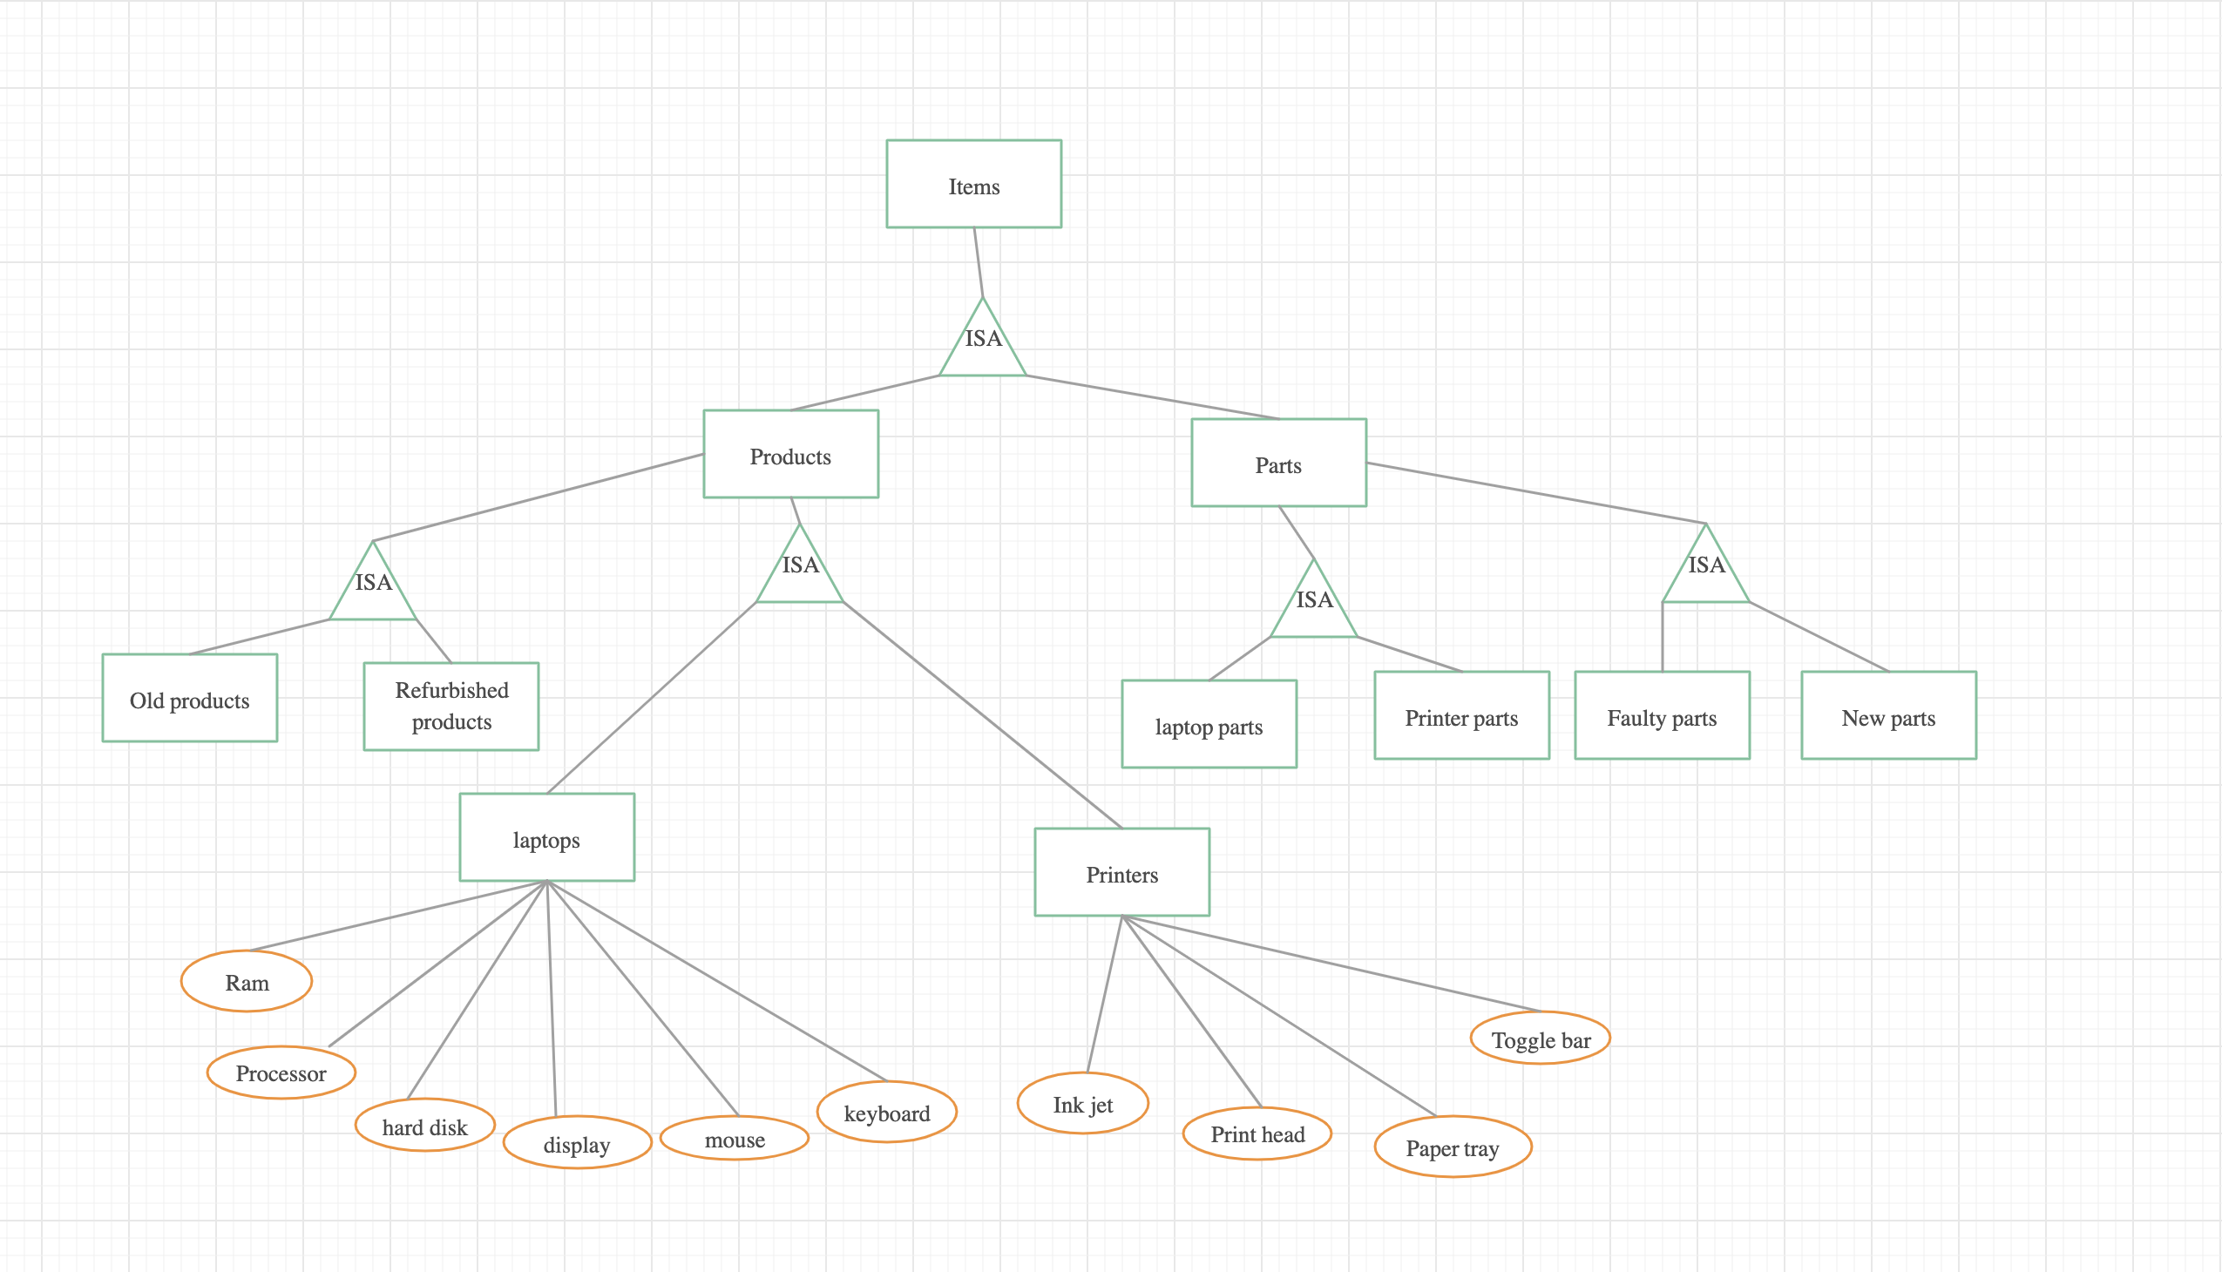
ER Diagram with Inheritance
94 | W4111_02_S20: Introduction to Databases -- Lecture 3,4

